Slide 1

Puck’s Wild Pansy
Love Your Network With Data Viz in Python
@infosecanon
A Midsummer Night’s Con
27 July 2020

Slide 2



About Me
Data Scientist with NARI
PhD student @ UCCS
6 Years USN
Hack@UCF, NCCDC
B-Sides Orlando Board Member, DEF CON Goon, Kernelcon volunteer

Slide 3

Takeaways
There are different data visualization options for different use cases
Same ‘No Free Lunch’ idea: More control means more work
But this is getting easier

Slide 4

Outline
Motivation
Visualization in Python
Feature selection & processing
Graph It!

Slide 5
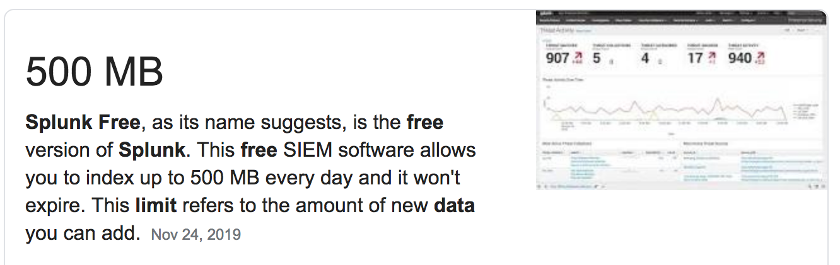
Motivation
One of those poor PhD students that needs to sort network data (often >500 Mb per dataset)
Budget = $0
Didn’t need a realtime dashboard (point in time not continuous)
Visualize
Feature selection / ML
Communicate to stakeholders
i.e. ‘to print’
Notes:
Also need to visualize ’data about the data’ or metadata to make feature selection decisions

Slide 6
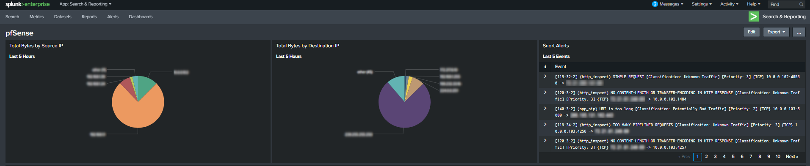
There are several ways this is done…
PCAP for Splunk
Splunk
Enterprise
Splunk
ML Toolkit
SPL
Splunk
Dashboard
Source: https://www.trenchesofit.com/2020/04/14/building-a-splunk-dashboard-for-pfsense/
Notes:
And by ‘this’ I mean ‘network visualization’

Slide 7
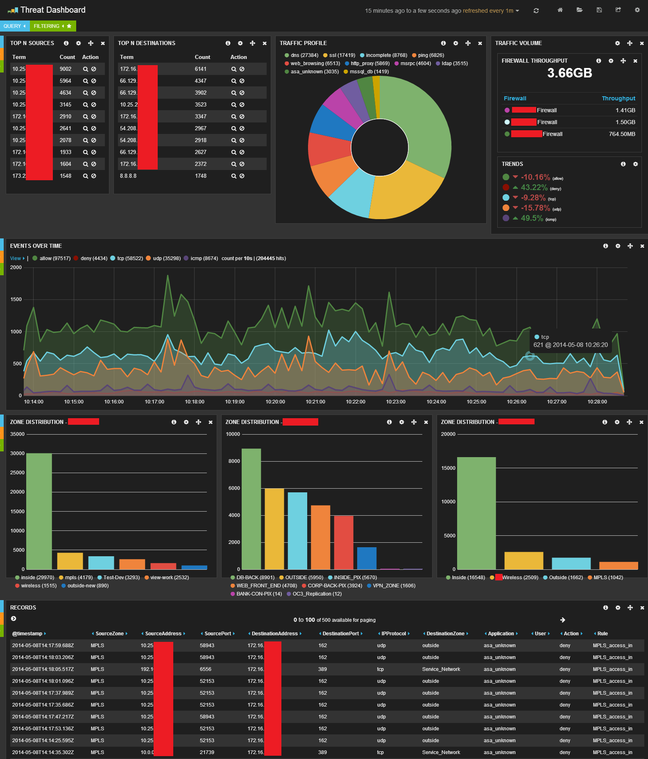
Elasticsearch
ML
Node
Kibana
Logstash
Source: https://operational.io/elk-for-network-operations/

Slide 8
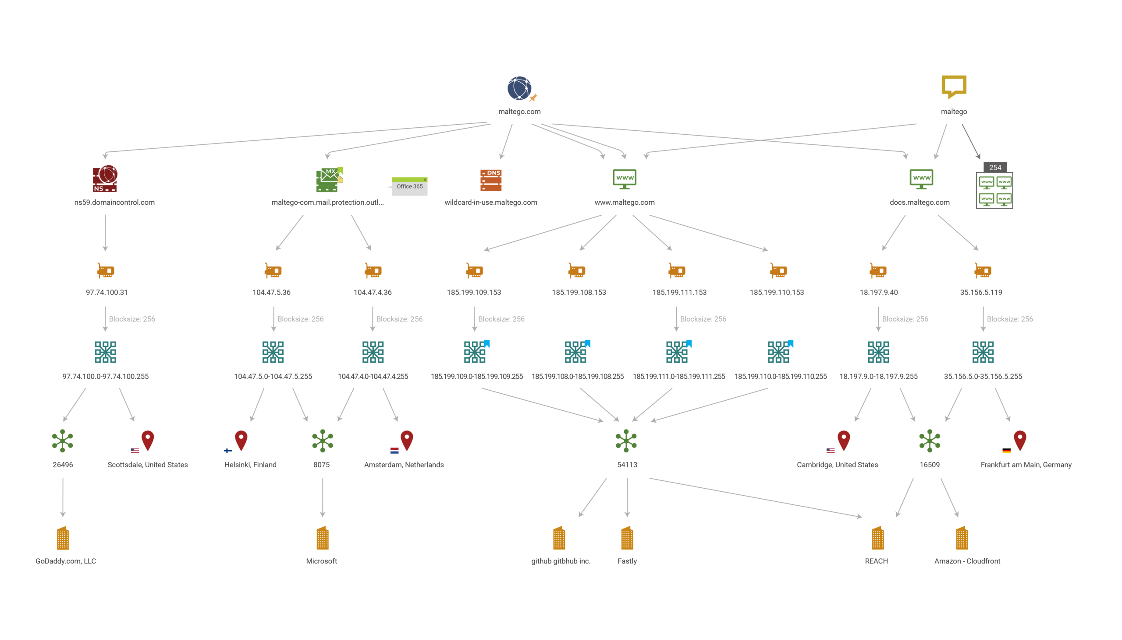
Maltego
Source: https://en.wikipedia.org/wiki/Maltego

Slide 9
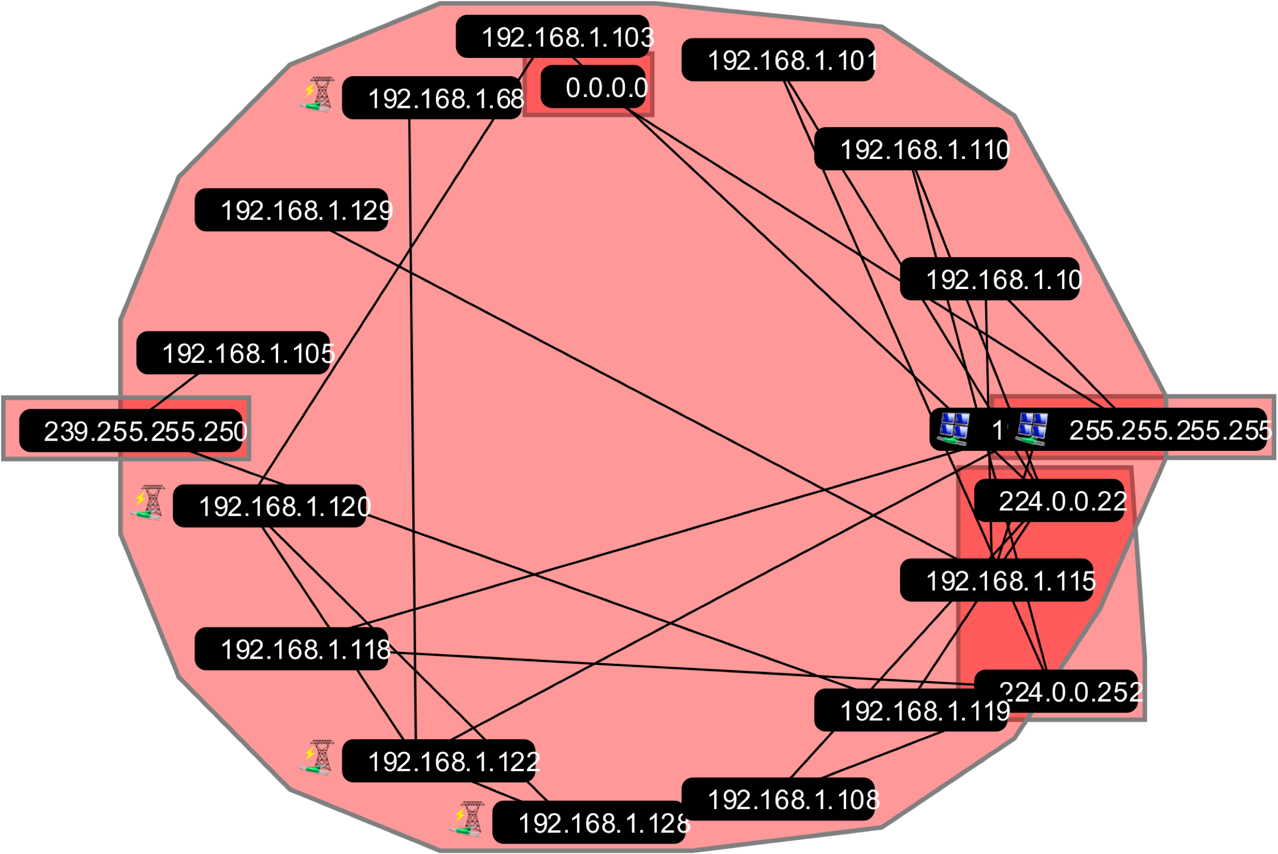
…to varying degrees of complexity
PCAP
Grass
Marlin
CSV, SVG

Slide 10
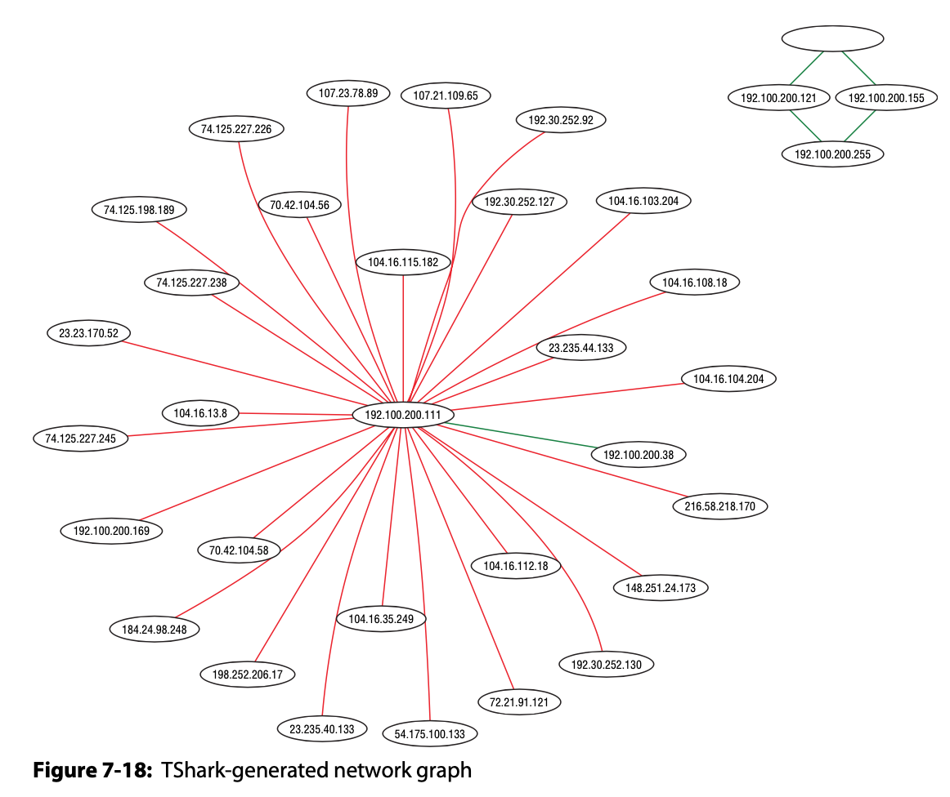
…to varying degrees of complexity
PCAP
tshark
Graphviz
Source: Wireshark for Security Professionals Using Wireshark and the Metasploit Framework, Jessey Bullock and Jeff T. Parker, Wiley, 2017.
Notes:
command-line interface TShark, along with Lua and the open source Graphviz visualization library

Slide 11

Visualization in Python

Slide 12
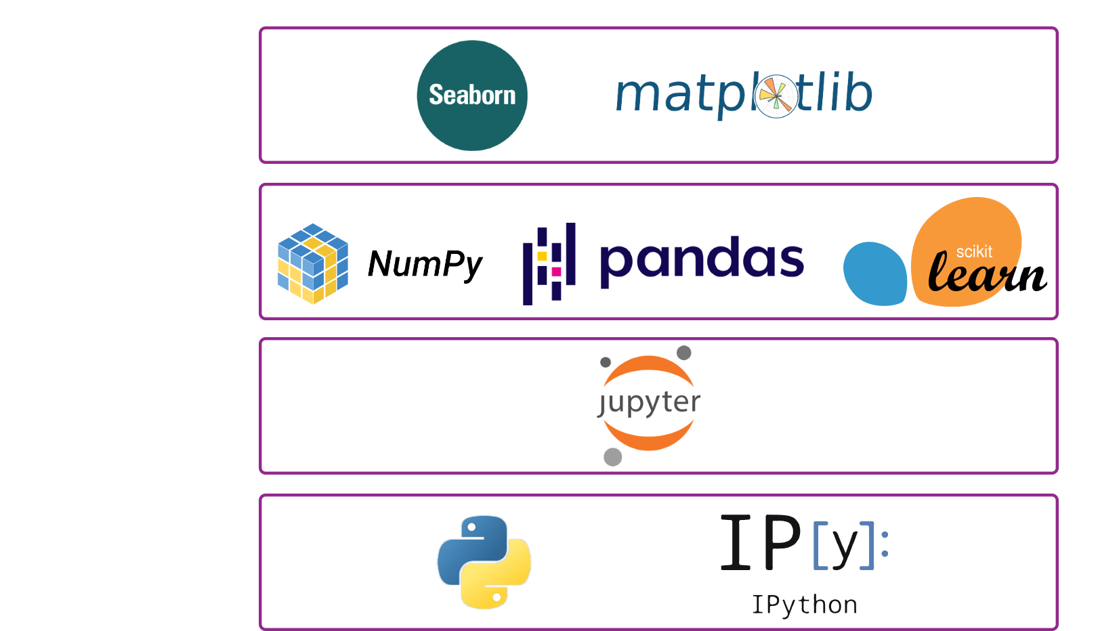
Visualize
Data
Manipulate
Data
View
Code
Base
Language
Source: chris35wills.github.io/courses/pydata_stack/
Notes:
Note this is a little different than a formal ‘stack’ as libraries like Seaborn rely on libraries below it while matplotlib is the main Python plotting library

Slide 13
Visualization Packages
Seaborn
Built on top of matplotlib
Closely integrated with pandas data structures
Built-in themes and color palettes
> import seaborn as sns
Matplotlib
Python’s main plotting library
Pyplot
> import matplotlib as plt

Slide 14
Visualization Packages
Networkx
Network graphing
> import networkx
bokeh
Interactive visualizations
> import bokeh

Slide 15

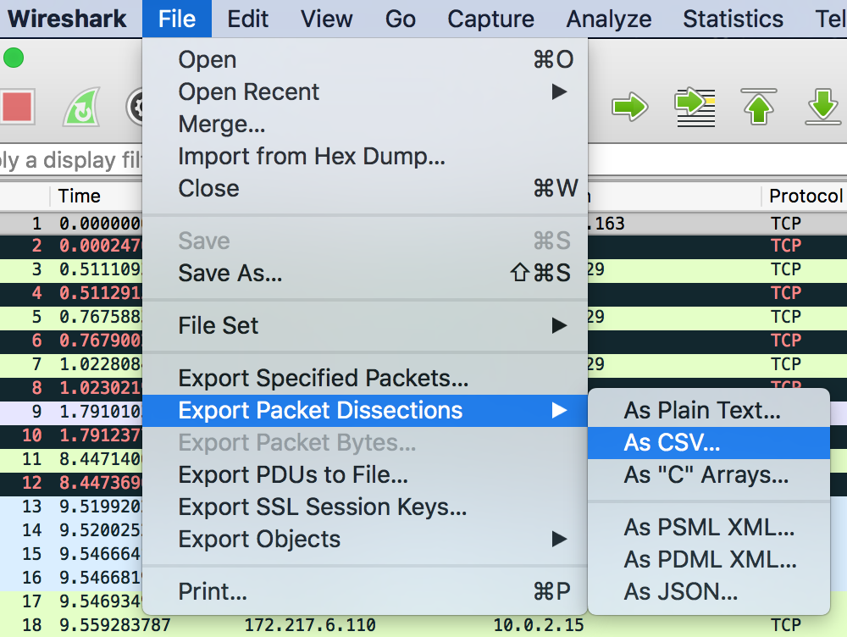
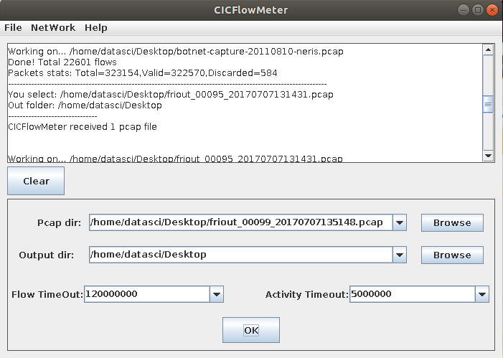
Converting .pcap .csv
Wireshark
"1","0.000000000","10.0.2.15","172.217.8.163","TCP","54","54888 > 80 [ACK] Seq=1 Ack=1 Win=29946 Len=0"
CICFlowMeter
Joy (Cisco)
Write your own
Notes:
What features you get depends on your parser

Slide 16

Feature Selection & Processing

Slide 17
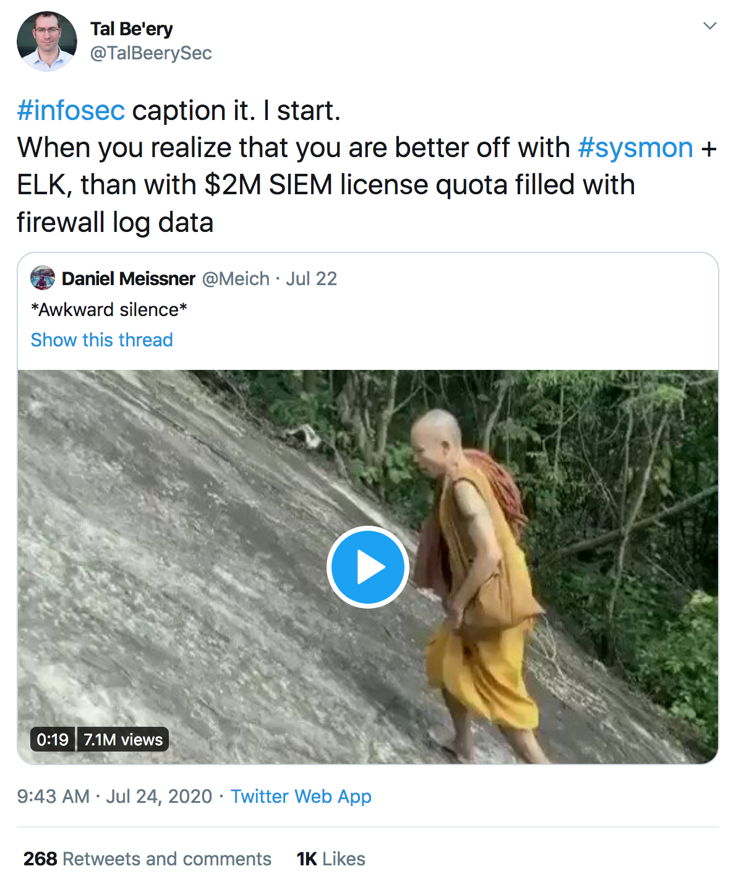

Slide 18
Feature Selection
Choosing which features to keep can save disk space and processing time (aka money)
Network data tends towards a higher number of features
CICFlowMeter provides 80 features from a .pcap
Irrelevant features may affect training performance

Slide 19

Feature Selection
Dimensionality Reduction
PCA
LDA
Unsupervised
Supervised
Intrinsic
Wrapper
Filters
Trees
Feature Importance
RFE
Stats
Source: Data Preparation for Machine Learning (2020) Dr. Jason Brownlee pg 19
Notes:
2 groups: methods that use the target variable (supervised) and those that don't (unsupervised)
Supervised
Intrinsic - Models that automatically select features as part of fitting the model
Wrapper - Supervised technique that explicitly chooses features that result in the best performing model
Filter - Supervised technique that scores each input feature and allows a subset to be selected
a wrapper method such as the popular Recursive Feature Elimination (RFE) method can be used that is agnostic to the input variable type.
Dimensionality Reduction – where you create a projection of the data into a lower-dimensional space that still preserves the most important properties of the original data. Techniques like Linear Discriminant Analysis (LDA) and Principal Component Analysis (PCA) fall under this.

Slide 20
Feature Selection
Dimensionality Reduction
PCA
LDA
Unsupervised
Supervised
Intrinsic
Wrapper
Filters
Trees
Feature Importance
RFE
Stats
Source: Data Preparation for Machine Learning (2020) Dr. Jason Brownlee pg 19
Notes:
2 groups: methods that use the target variable (supervised) and those that don't (unsupervised)
Supervised
Intrinsic - Models that automatically select features as part of fitting the model
Wrapper - Supervised technique that explicitly chooses features that result in the best performing model
Filter - Supervised technique that scores each input feature and allows a subset to be selected
a wrapper method such as the popular Recursive Feature Elimination (RFE) method can be used that is agnostic to the input variable type.
Dimensionality Reduction – where you create a projection of the data into a lower-dimensional space that still preserves the most important properties of the original data. Techniques like Linear Discriminant Analysis (LDA) and Principal Component Analysis (PCA) fall under this.

Slide 21
Recursive Feature Elimination (RFE)
Wrapper method
A different ML algorithm is used in the core of the method and wrapped by RFE to help select features
Decision Tree, Random Forest, Gradient Boosting
Works by searching for a subset of features by starting with all features in the training dataset and successfully removing features until the desired number remains
The core algorithm ranks features by importance, discarding the least important features, and refitting the model

Slide 22
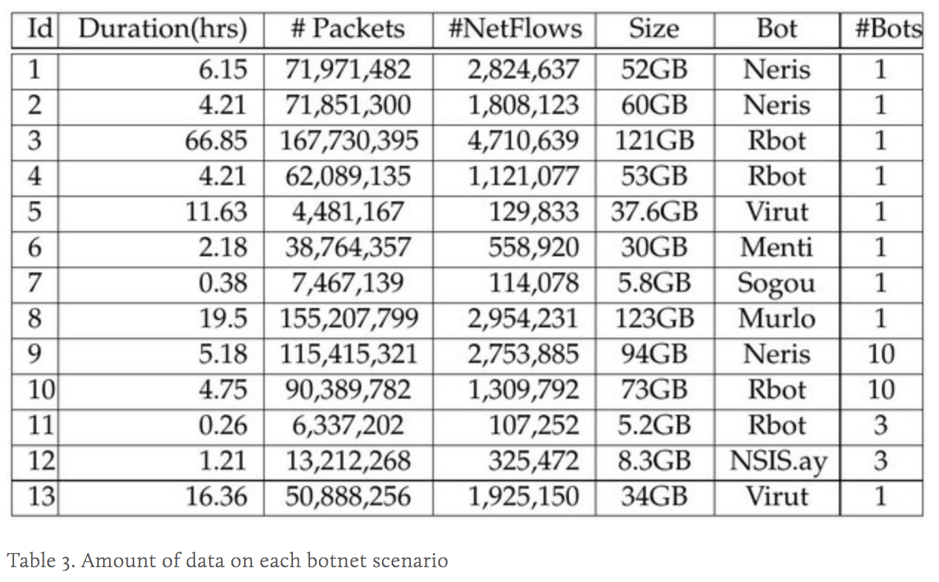
About the Dataset I’m Using
CTU-13
Botnet dataset published by Garcia, et al.
(https://www.stratosphereips.org/datasets-ctu13)

Slide 23
Graph It!
https://infosecanon.github.io/blog/2020/07/27/a-midsummer-nights-con
https://tinyurl.com/yxzq8g93

Slide 24

References
Data Preparation for Machine Learning (2020) Dr. Jason Brownlee
An empirical comparison of botnet detection methods. Sebastian Garcia, Martin Grill, Jan Stiborek and Alejandro Zunino. Computers and Security Journal, Elsevier. 2014. Vol 45, pp 100-123. http://dx.doi.org/10.1016/j.cose.2014.05.011
https://github.com/OTRF/infosec-jupyterthon
http://blog.uncommonsensesecurity.com/
https://github.com/scikit-learn-contrib/boruta_py

Slide 25

Slides & Code
Get the slides and notebooks used for this talk here:
https://github.com/infosecanon/Machine-Learning-Demos/

